Slide 1
Using Anchor Points to Define and Transfer Spatial Regions Based on Context
Matt Klenk
PARC
Nick Hawes
University of Birmingham
Kate Lockwood
California State University – Monterey Bay
Graham Horn
University of Birmingham
John Kelleher
Dublin Institue of Technology

Slide 2
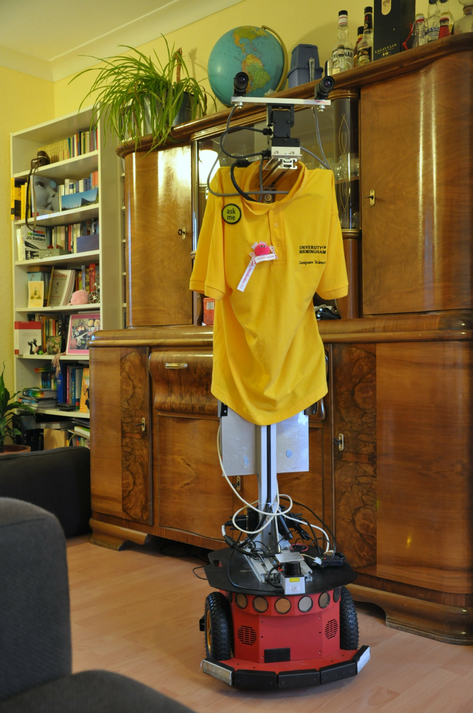

Slide 3
Context Dependent Spatial Regions
Environments are Defined by Context as well as Geometry

Slide 4
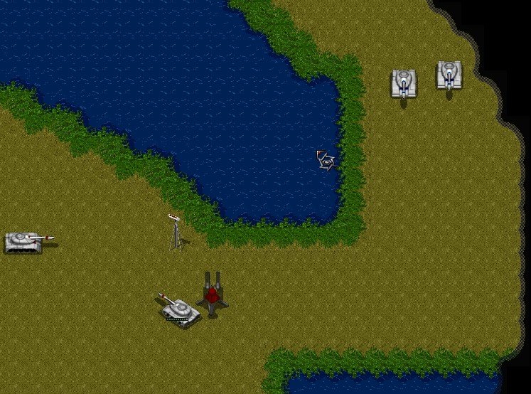
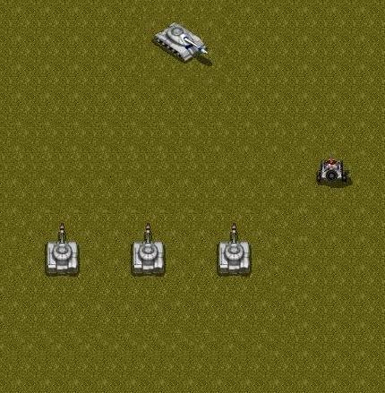

Slide 5


Slide 6


Slide 7


Slide 8


Slide 9
The Problem
From Sensor to Semantics
Increasing interest in the Robotics community
(e.g., Special Issue of Robotics and Autonomous Systems 2008, 2 AAAI-12 Workshops)
QR is all about making the relevant distinctions to solve problems
Why is this hard?
Integrate geometric, semantic, and relational reasoning

Slide 10
Cognitive Systems Solution
Qualitative spatial representations
RCC-8 + Positional relationships between entities
Symbolically describe regions
Anchor points (Klenk et al. 2005)
Incremental learning from a single case
Analogy SME (Falkenhainer et al. 1989)

Slide 11
From Sensors to Symbols

Slide 14
Explore the classroom
Dora

Slide 16
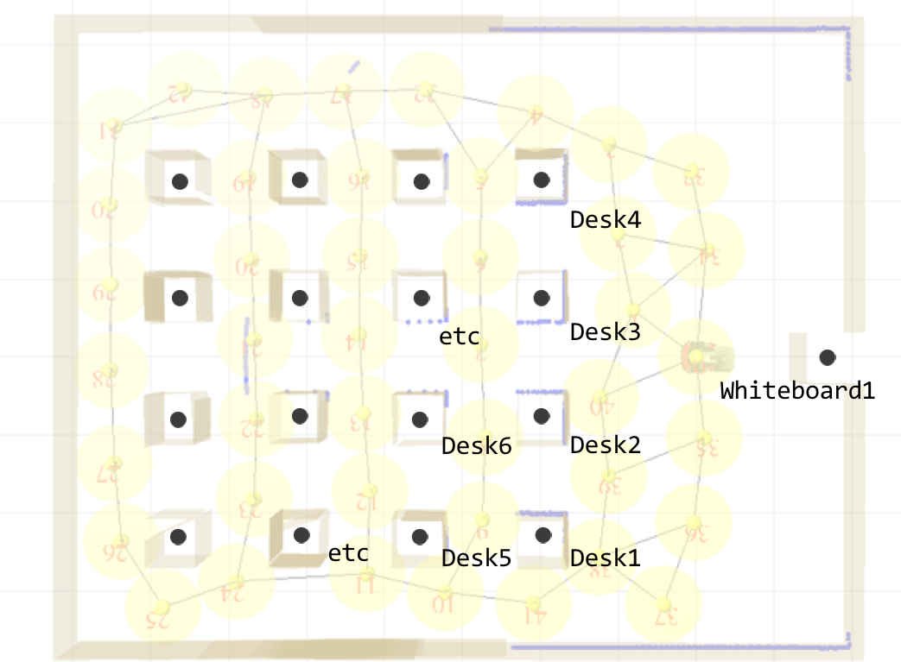

Slide 17
Create group entities for each set of adjacent objects with the same type

Slide 20
QSRs

Slide 21
Defining CDSRs with Anchor Points

Slide 22
Anchor Points

Slide 23
Region Boundary Segment

Slide 24
Instance-Based Learning

Slide 25
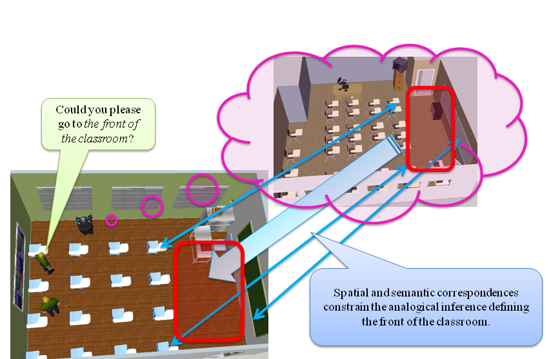
Goal

Slide 26
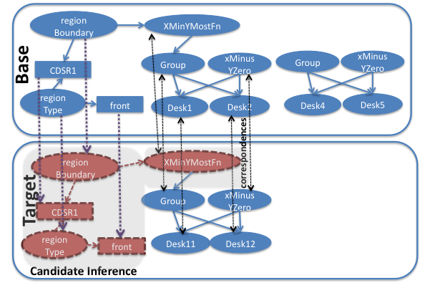
Analogical Inference

Slide 27
Experiment

Slide 28
Purpose
Are anchor points able to encode context dependent spatial regions?
Can we identify context dependent spatial regions by analogy with an understood example?

Slide 29
Materials
6 classrooms and 2 studio apartments
4 of the classrooms were real
4 regions per classroom, 3 regions per apartment
Manually encoded regions for each room
Ground truth from 3 human subjects

Slide 30
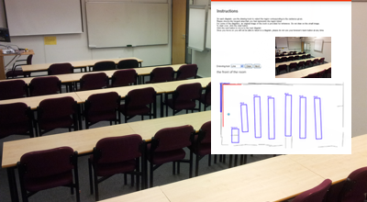
Subjects are asked to draw a polygon for the region of the front of the room
Geometric sensor data from the room in the picture.

Slide 31
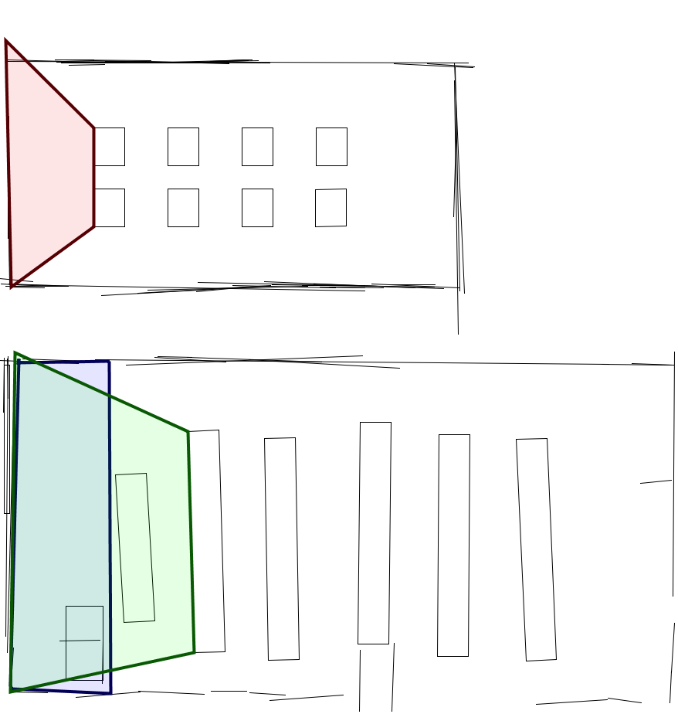
Manually encoded front of the classroom
Source
Human subject’s front of the classroom
Target
Analogically transferred front of the classroom

Slide 32
Metrics

Slide 33
Results
Entire room provides a baseline for comparison
Anchor points can representing context dependent spatial regions
Anchor points provide a symbolic representation suitable for analogy

Slide 34
Current Limitations
Assumes same orientation
Future work: Qualitative rotations for best match
No anchor point for area “near”
Future work: Potential field models tied to anchor points
No transfer post-processing
Future work: compare the QSRs of the transferred region to that of the source region

Slide 35
Related Work
Spatial Semantic Hierarchy (Kuipers)
NuSketch Battlespace (Forbus et al. 2003)
Identified regions of potential ambushes
McClure & Forbus (2012)

Slide 36
Discussion
Extract symbolic representations from sensor data
Ground regions in sensor data using anchor points
Transfer context dependent spatial regions based on spatial and semantic similarity

Slide 37
Thank you
Questions?

Slide 38
Backup

